Slide 1


Supervisor
Team Members
Mr. Usman Ghous
19F-0170 Danish Ahmad
19F-0228 Muhammad Zain
19F-0328 Muhammad Umar
Co-Supervisor
Dr Umar Aftab

Slide 2
Introduction
01.
Animals are one of the most common and important parts of daily life. So, our project is based on a community filled with pet enthusiasts.
02.
With our system, people can engage and solve their daily life queries about their pets and other stray animals.
03.
So, our project is based on a community filled with animal enthusiasts.
01.

Slide 3
Modules/Features
.
.
Chat
Payments
.
.
Newsfeed
Contact NGO’s
.
.
Alerts
Nearby Pet shops
.
.
Post Ad’s
Avail Services
.
.
Pet Shows
Search Items
.
.
Rent/Adopt Pet’s
Authentic Pet
.
Add to cart
02.

Slide 4
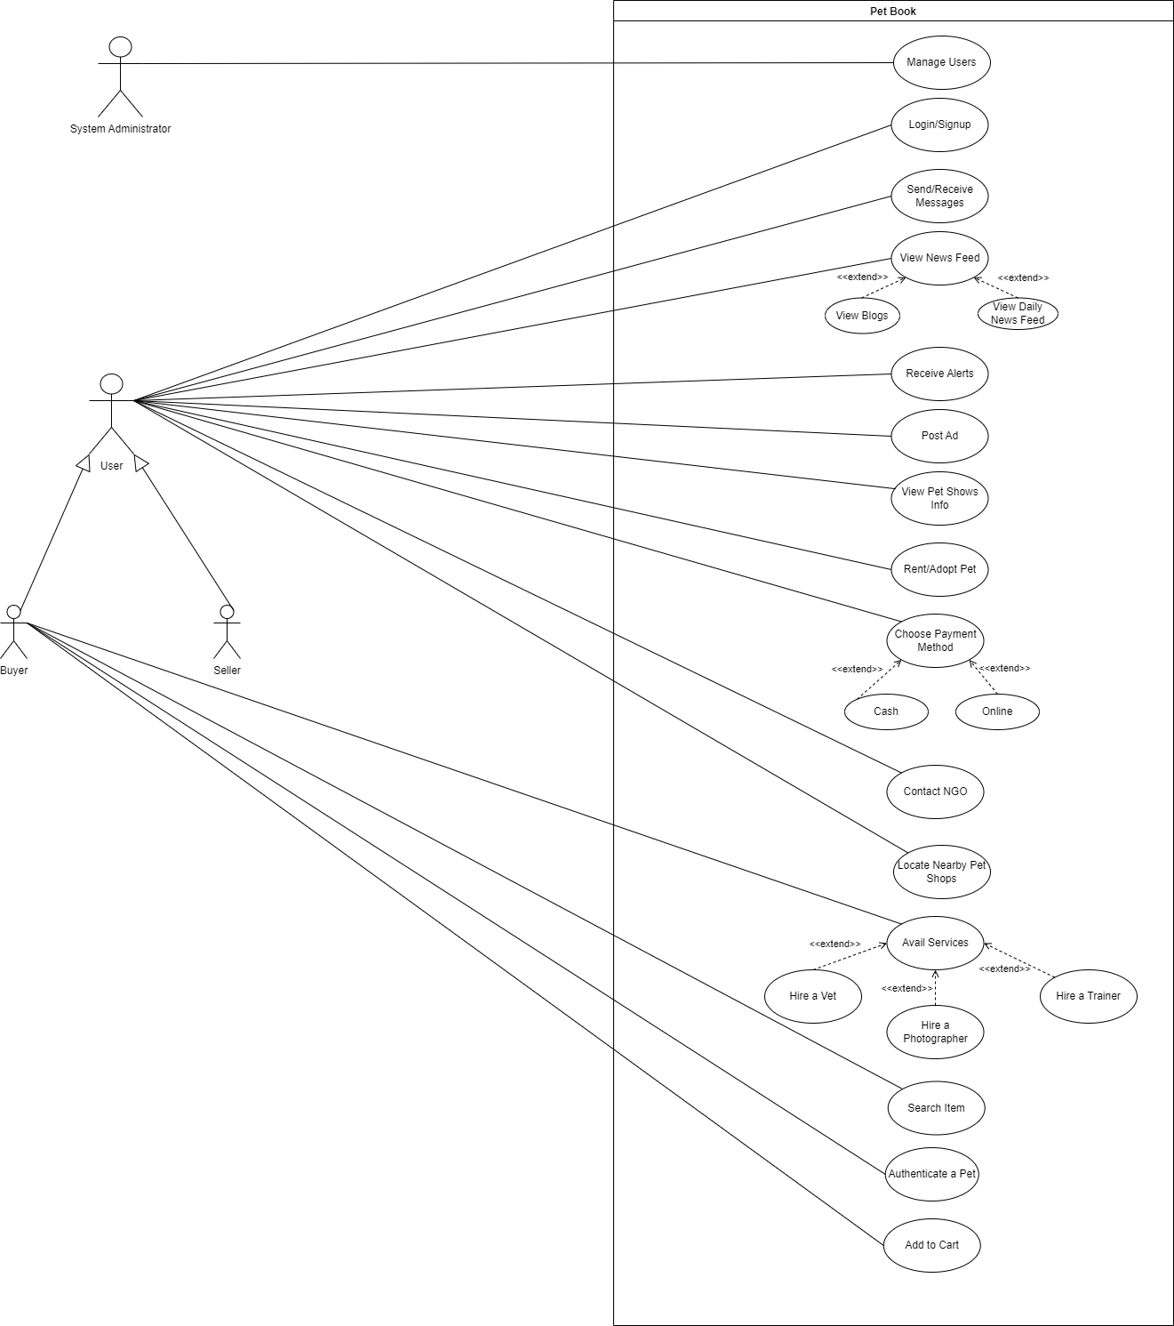
Use Case Diagram

Slide 5
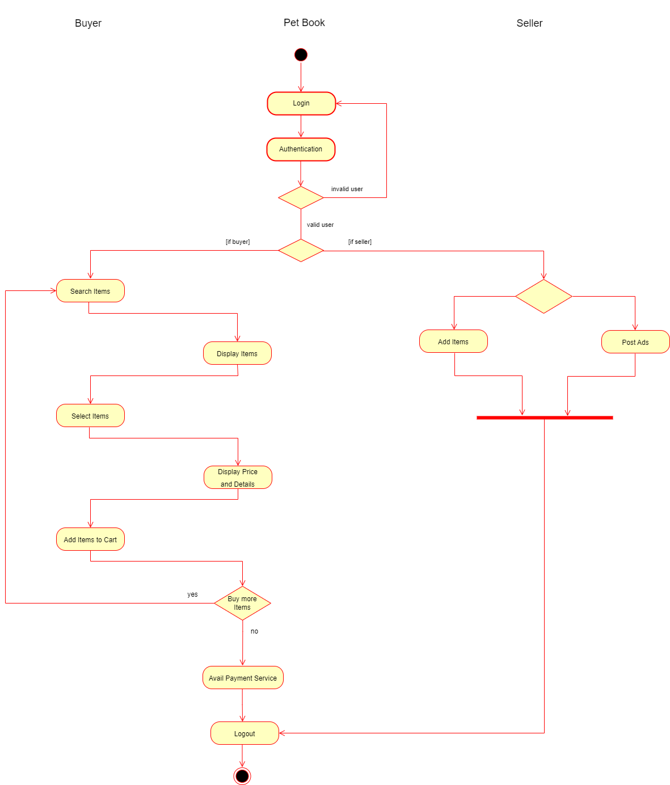

Slide 6
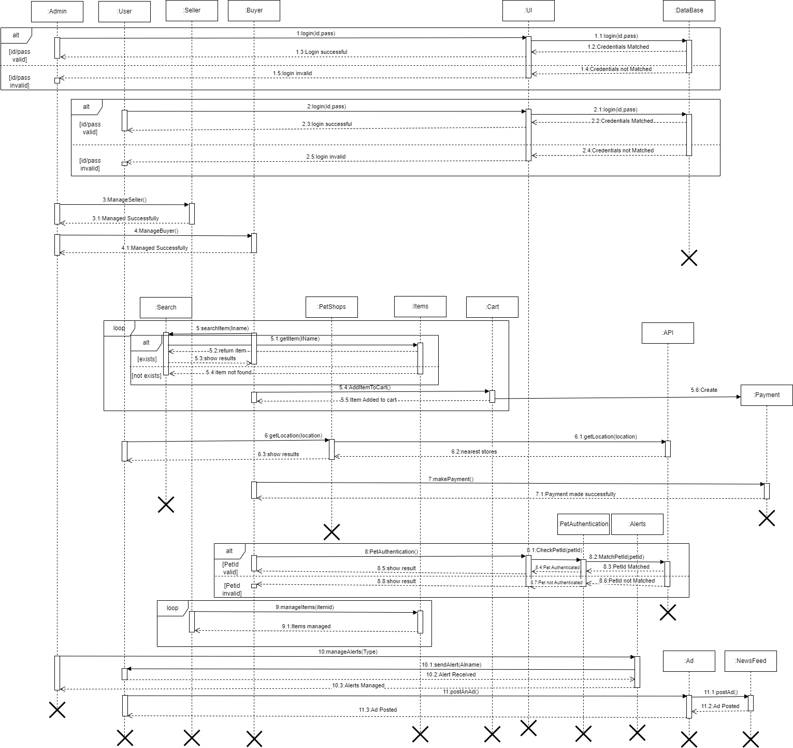
Sequence
Diagram

Slide 7
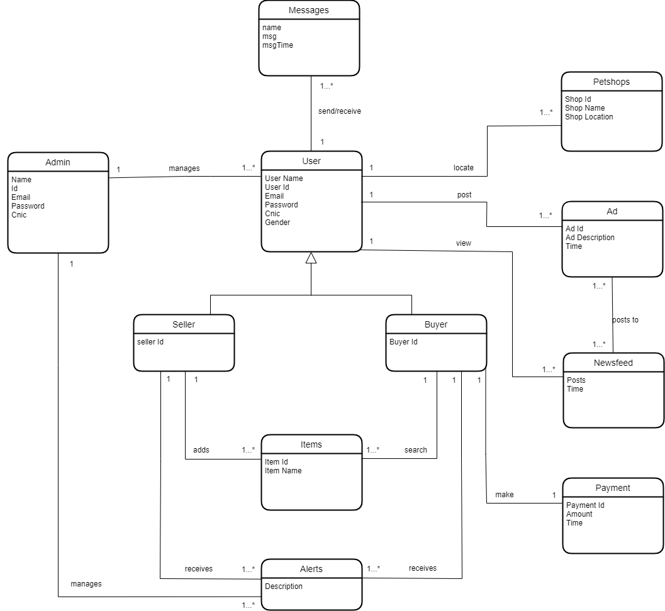
Domain Model

Slide 8
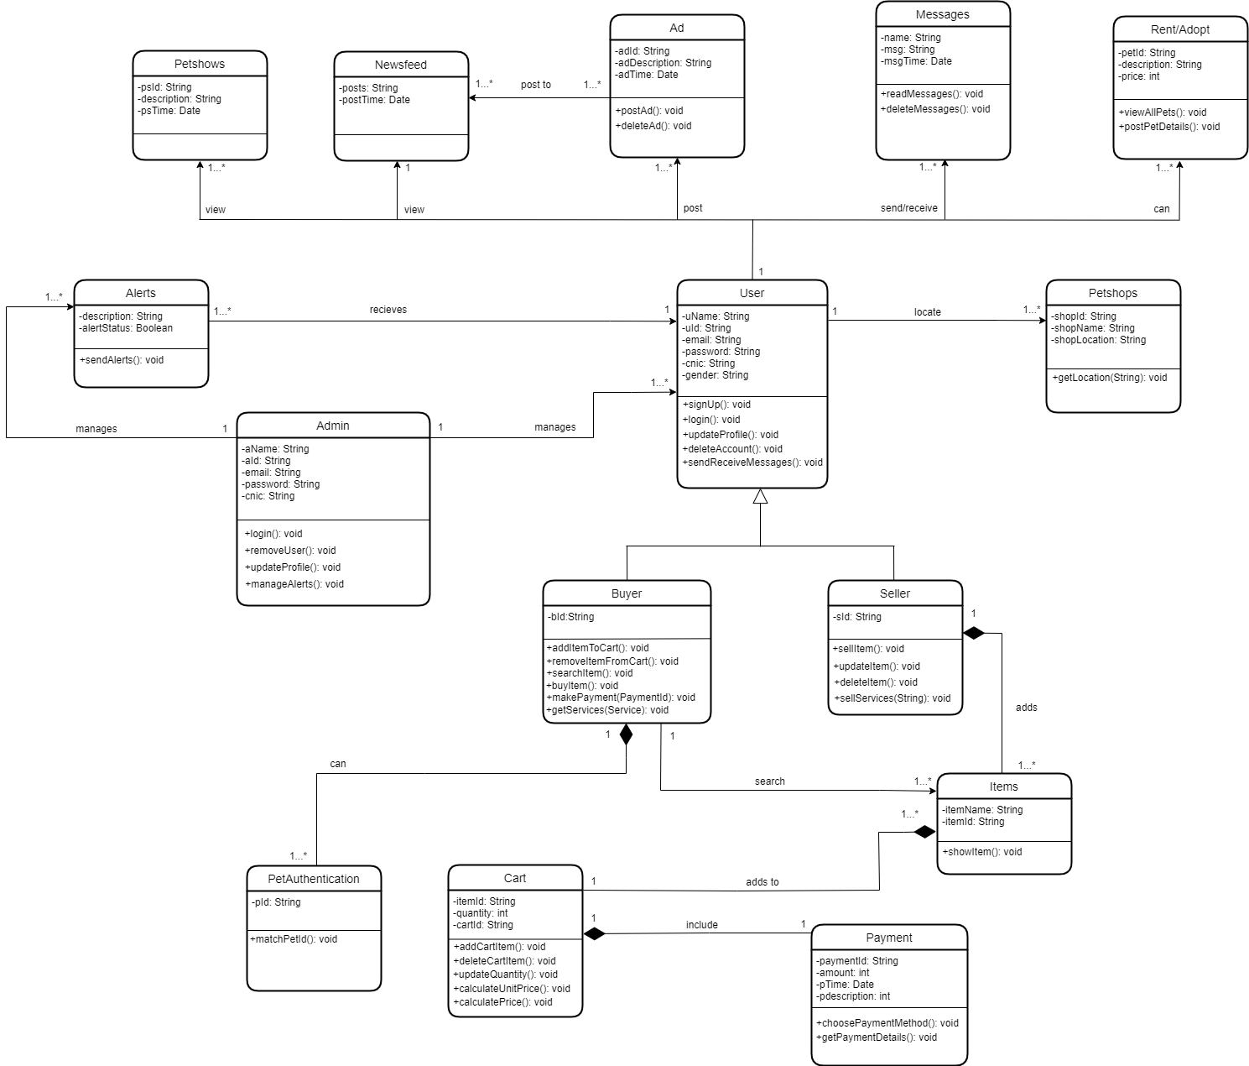
Class
Diagram

Slide 9
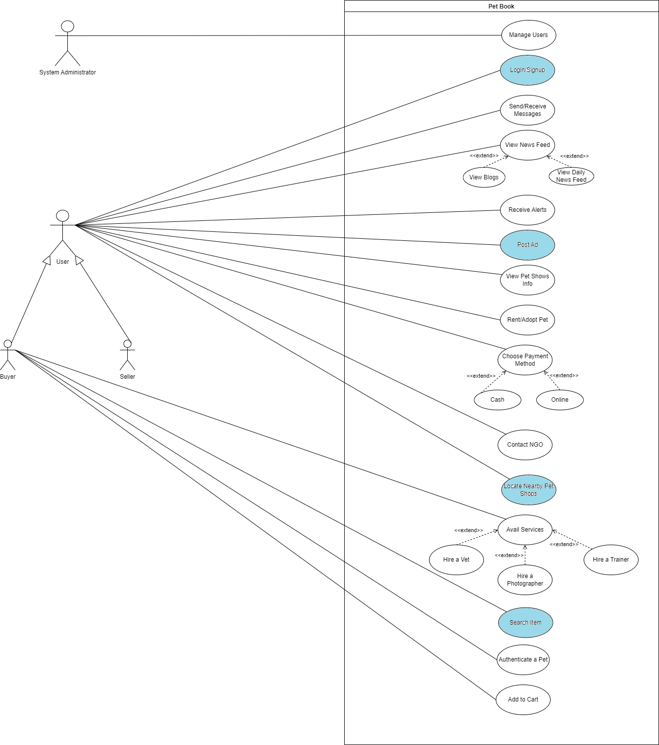
Committed Use Cases
and implemented

Slide 10
Thank you!

